Slide 1
Gene expression databases
Sean Eddy, PhD

Slide 2
Outline
How to measure gene expression?
Microarrays/RNA-seq
What are gene expression databases?
Which ones exist?
How do they differ?
How can they be used?
What needs to be taken care of?
What can I do with specialized databases?

Slide 3
Microarrays: the beginning of high throughput gene expression
Compartmentalized chips with sequences bound to the surface
Sample is applied to surface
Hybridizes to complementary sequence
Hybridizations are quantified
No binding, “no” signal
Can only find what is specifically searched for
Usually represented as n x m matrix
http://www.nature.com/nrd/journal/v1/n12/images/nrd961-f1.gif

Slide 4
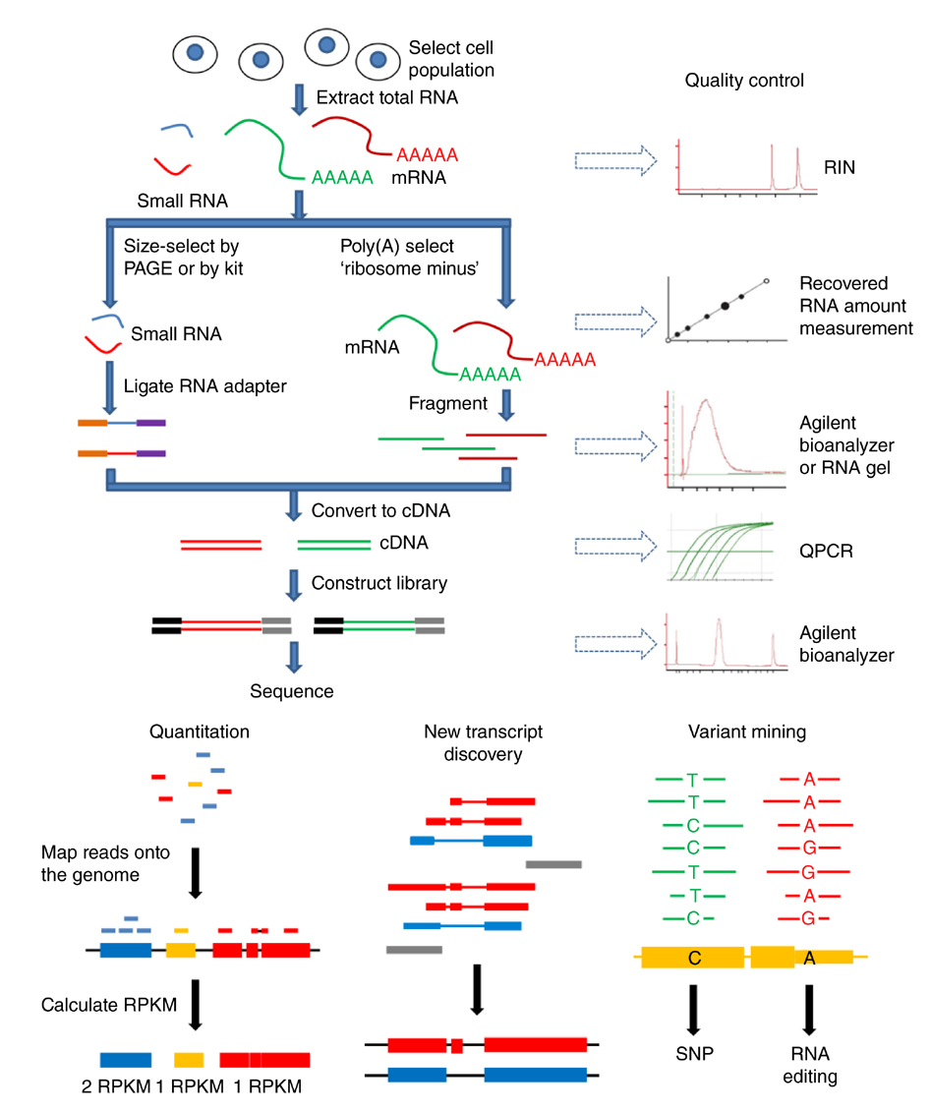
RNA-seq: the future of high throughput gene expression
Samples (cDNA libraries) are applied to a sequencer
Millions of sequences are generated and mapped onto a genome
Sequence reads are quantified
No sequence = no expression
Can find novel transcripts, splice isoforms, fusion genes, etc.
Quality of mapping depends largely on library prep and decisions made on how RNA is initially processed.

Slide 5
Gene expression databases
Repositories for gene expression data
Mostly microarray and now RNAseq
Primarily for storage
Curated or un-curated
Access to data on different levels:
Datasets
Individual levels
Integrated databases
Contain array data and additional data of the samples
Array data tends to be more annotated
More analytical tools
Smaller (more QC and curation needed)
Often no direct data access

Slide 6
Why do they exist
Transparency/reproducibility of publications
Journals require data to be available for analysis
Nowadays raw data is required
Databases offer single resource and standardized access
Data was generated for a specific purpose, but is not limited to that purpose
Can be reanalyzed in a different context
Can be combined with other datasets
Can be used as independent validation

Slide 7
Gene expression repository examples
Gene expression omnibus (www.ncbi.nlm.nih/geo/)
1,117,462 samples, 3848 datasets
Array express (www.ebi.ac.uk/arrayexpress/)
Princeton University MicroArray database (PUMAdb)
40084 experiments, 6598 made public
NCBI SRA, ENA and Princeton HTseq for NGS data

Slide 8
What is in a gene expression database?
Gene expression data in different forms:
Resolution:
Gene level
Transcript level
Exon level
And / or raw data
Comprehensiveness
Targeted arrays
Whole genome arrays
Different platforms (microarrays, RNAseq)
Generally only gene expression, may have limited sample information

Slide 9
Where does the data come from?
Expression profiles of
Patients
Model systems
Cell cultures
Data used for publication
Most journals now require raw data submission
Very coarse quality control (peer review)
QC depends mostly on authors
Datasets submitted without publication
Little or no QC
Most datasets are tailored towards a specific question

Slide 10
Example: GEO GSE32591
Go to http://www.ncbi.nlm.nih.gov/geo/
Enter GSE32591 into search box
Click on “Analyze with GEO2R”
How would you set up the groups for analysis?
What do you get?
Does that make sense? How can results be verified?
Go to “value distribution” tab
What do you see?
What are possible explanations?

Slide 12
What can be done with GEO?

Slide 13
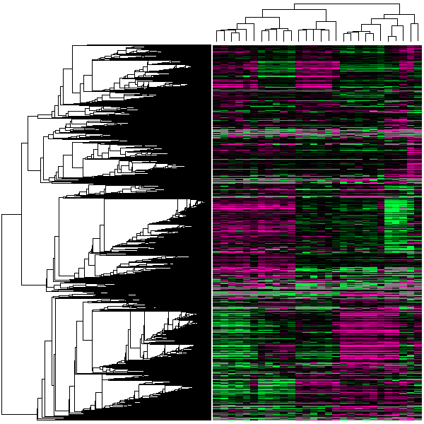
What can be done with GEO?
Programmatic access for data download
http://www.ncbi.nlm.nih.gov/geo/info/geo_paccess.html (GEO)
http://www.ebi.ac.uk/arrayexpress/help/programmatic_access.html (ArrayExpress)
Pre-computed analyses and on the fly analyses
Search by gene across all GEO experiments
Search by experiment to retrieve cluster analysis
Search by gene sequence for matching expression profiles
Described by Barret and Edgar, Methods Mol. Biol. 2006 “Mining Microarray Data at NCBI’s Gene Expression Omnibus (GEO)”
http://www.ncbi.nlm.nih.gov/pmc/articles/PMC1619899/

Slide 14
What questions can be answered?

Slide 15
What questions can be answered?
If you download: anything
Only limited by your knowledge, skills, resources
Pre-computed results
Preselected analysis methods/ sample groups
Generally within one dataset
On-the-fly analyses
Sets of genes that cluster in under conditions given
Sample properties may not be entirely transparent.

Slide 16
What can be answered by doing it yourself?

Slide 17
What can be answered by doing it yourself?
The quality of the data
Is part of the data low quality?
Does some of the data not fit into the set (e.g. batch effect, outliers for other reasons)
Is it adequately processed?
What is the relationship between expression data and non-expression variables?
How does my gene (of interest) associated with experimental treatments, clinical parameters?
What are patterns across datasets?
Does my finding hold up across similar analyses in independent datasets?

Slide 18
Why do you have to do it yourself?
Quality control:
QC parameters are often glossed over in papers and in micraorray submissions
For Affymetrix QC modules are available, freely available and widely accepted in the bioinformatic community
Other array types have distinct, but also similar properties
http://www.nature.com/nbt/focus/maqc/index.html
Relations to non-expression data variables
Data is often not standardized within fields
Potentially irrelevant across fields

Slide 19
Why not?
Analysis across datasets:
Because:…. How?
Need to find a common standard for identification
Values need to be made comparable
If absolute expression values used, dynamic range can be a problem
Is ratios used, information about expression level lost
Non-expression data even worse

Slide 20
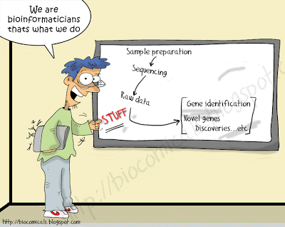
Who is the target group for doing it yourself?
Users with experience in expression data
Crucial information (STUFF) is missing

Slide 21
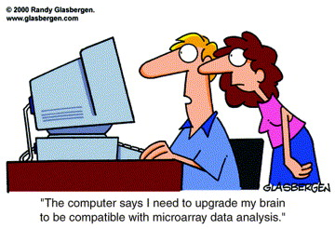
Why is this a problem?
Excludes investigators with good hypotheses but lacking bioinformatic skills

Slide 22
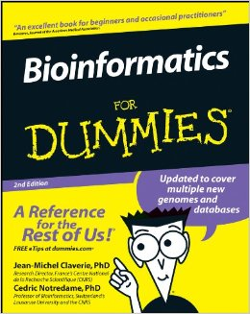
How to fix that?

Slide 23
How to fix that?
Specialized databases
Datasets are easier to find
Datasets relevant to specific areas are collected in one place
NephroSeq for renal disease
Oncomine for cancer
Datasets are standardized and expertly curated
Controlled vocabulary is introduced for non-expression data
Curation of expression possible by introducing standardized references and data transformations across datasets
Gene IDs/Gene Symbols as references
Z-transformation or median centering of log transformed expression data

Slide 24
Nephroseq ( www.nephroseq.org )

Slide 25
Oncomine (www.oncomine.com www.oncomine.org )

Slide 26
NephroSeq and Oncomine
Pros:
Each focus on one area of interest
Clinical data for many individual samples available
Advanced analysis using integrated systems biology tools in a pre-defined automated manner
Meta analysis possible
User friendly, free accessible for academic users
Hypotheses-generating
Cons:
No raw data download
No programmatic access
Only predefined analyzes

Slide 27
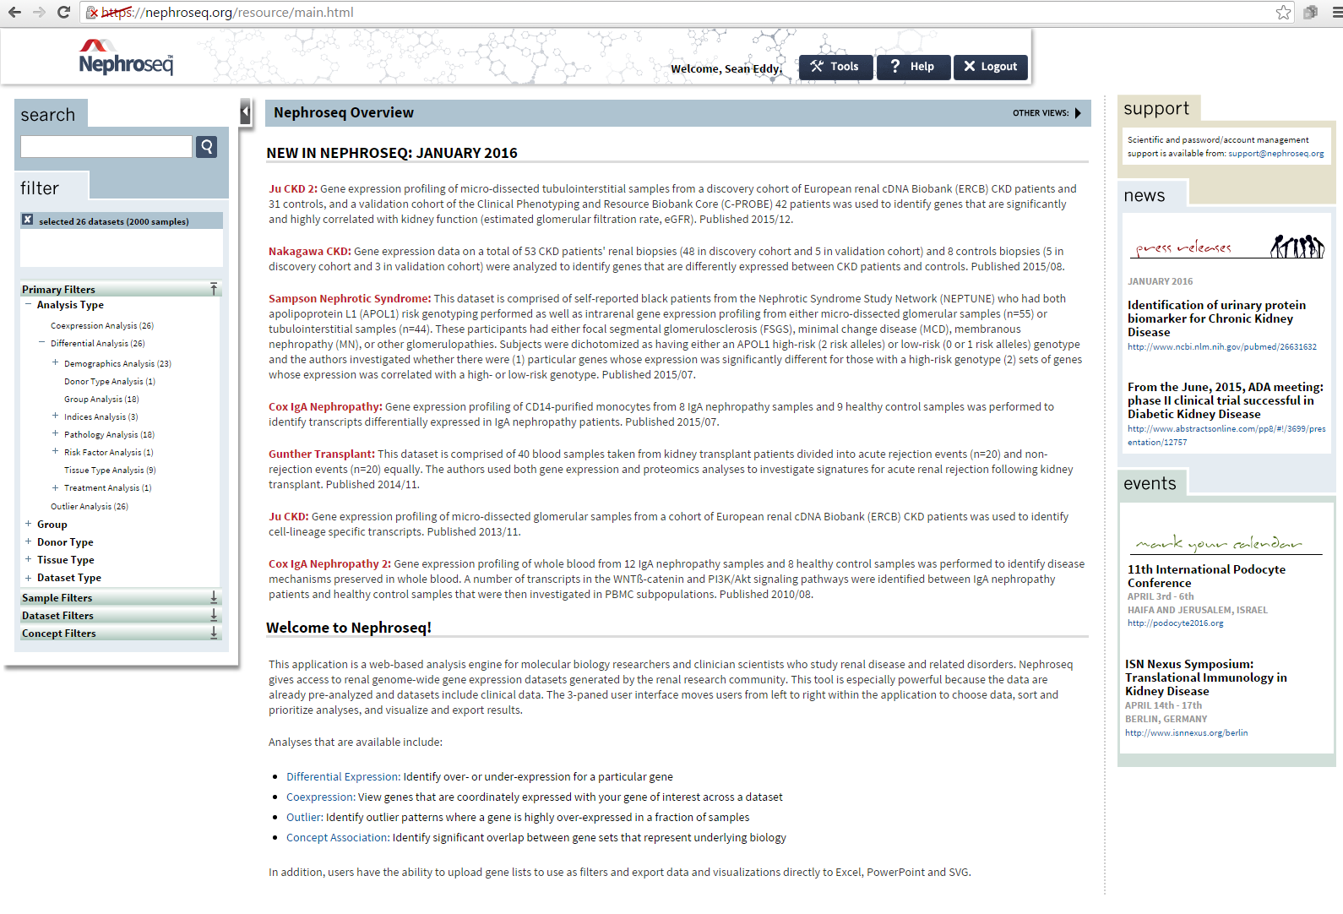
NephroSeq main Page
? HELP
26 datasets (2000 samples)
Analysis type
Coexpression analysis
Differential analysis
Outlier analysis
Notes:
Ongoing project, 2-3 times/year new data upload, latest update is available in the main page.

Slide 28
Two Search Options
Gene specific search:
Gene
Dataset search:
Specific conditions/diseases

Slide 29
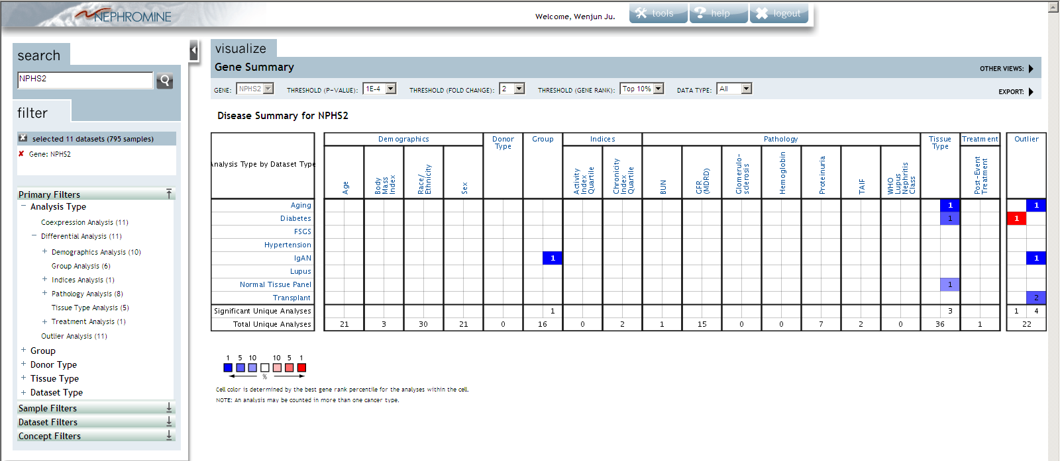
Gene Search
NPHS2: encodes podocin,
a podocyte specific protein
Gene summary view
Demographics
Dataset/Disease type
Notes:
NPHS2, encoding the glomerular protein podocin, is mutated in autosomal recessive steroid-resistant nephrotic syndrome". Nat Genet
Podocin, a raft-associated component of the glomerular slit diaphragm, interacts with CD2AP and nephrin

Slide 30
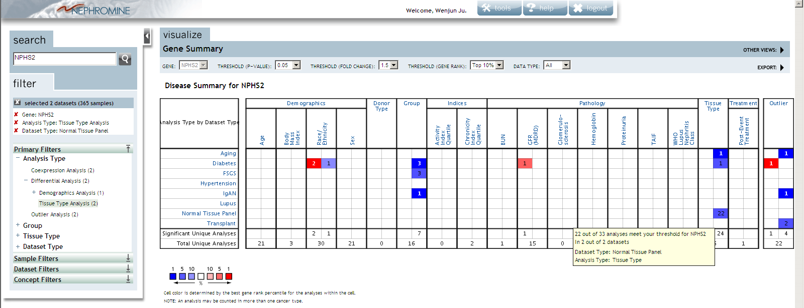
Gene Search
Gene summary view
22 out of 33 analysis meet your threshold for NPHS2 in 2 out of 2 datasets

Slide 31
Four Basic Analysis Modes
Differential expression
Co-expression analysis
Outlier analysis
Heterogeneity within predefined groups
Concepts analysis
Gene set (Nephromine & third-party sources)
Notes:
concepts are sets of genes representing some aspect of biology. Concepts are derived from both Nephromine gene expression signatures as well as third-party sources such as Gene Ontology, KEGG Pathways, Human Protein Reference Database, etc.

Slide 32
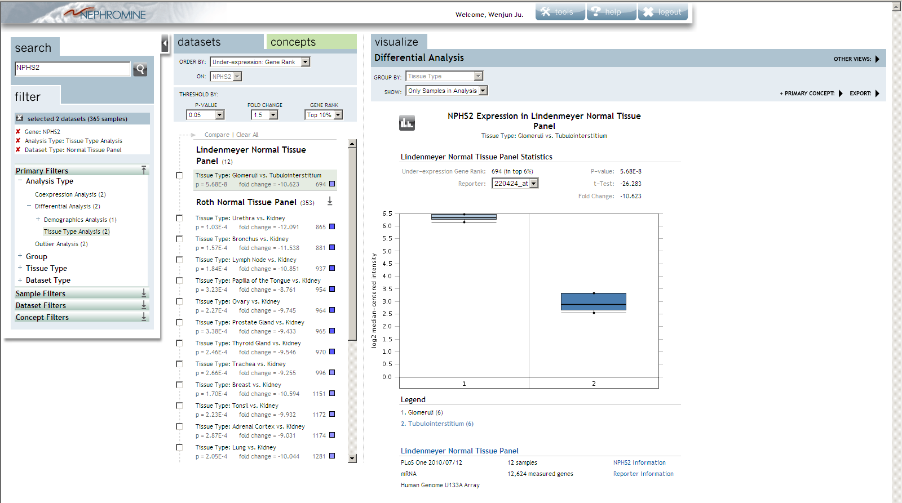
Gene Search
Differential expression
(Box graph)
Reference

Slide 33
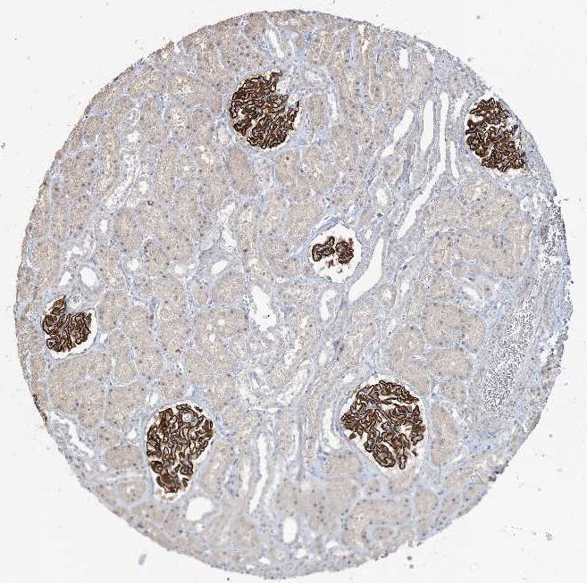
Tubulointerstitial
Glomeruli

Slide 34
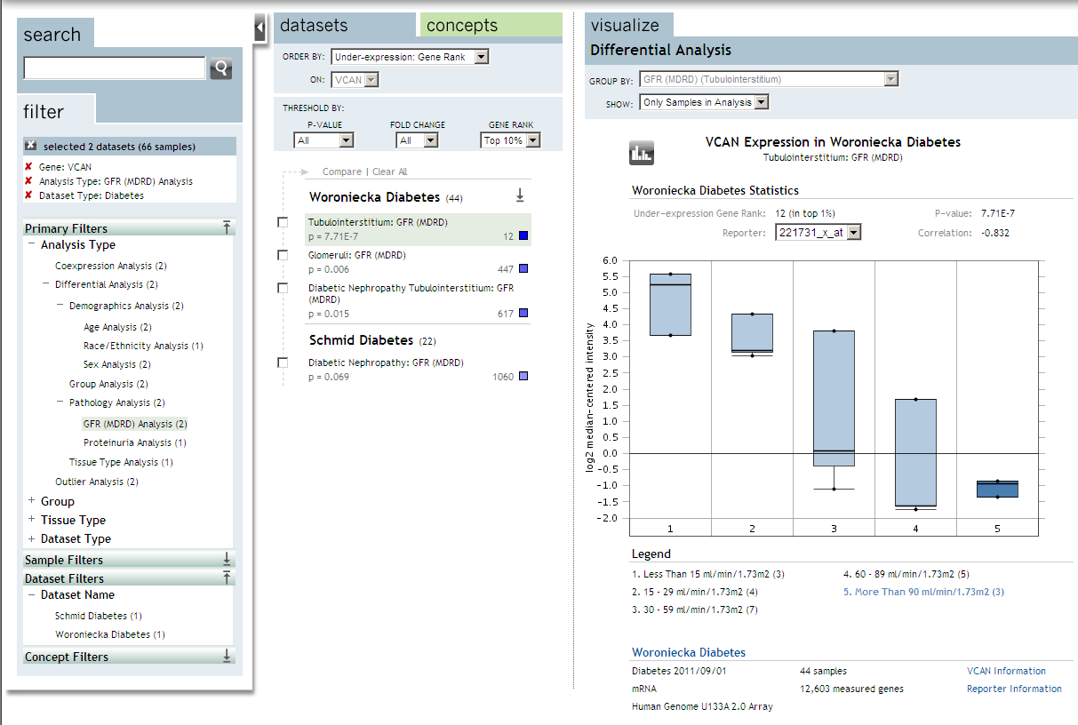
Gene Search
Correlation with clinical continuous variation
Gene: VCAN
Analysis type: GFR
Dataset Type: Diabetes
VCAN
P=7.71E-7
Correlation: -0.832
Legend
1. < 15 ml/min/1.73m2 (3)
2. 15 - 29 ml/min/1.73m2 (4)
3. 30 - 59 ml/min/1.73m2 (7)
4. 60 - 89 ml/min/1.73m2 (5)
5. > 90 ml/min/1.73m2 (3)

Slide 35
Gene Search
Outlier analysis
Outlier analysis helps to identify an expression profile where differential pattern is only seen in a fraction of samples of all patients within a disease type.
Why do we need it: 25% of patients show over-expression of a gene. This gene may not generate a significant p-value in a t-test comparing DN relative to normal kidney.
How to do it: Transform all samples within a dataset, so that genes could be ranked by their expression from high to low. The data transformation is performed at certain percentile bins (75, 90 & 95%), and a line is drawn at the percentile of that analysis to define outliers.
For example, in an outlier analysis at the 75th percentile, the system draws a line at the point at which only the top 25th percentile samples extend above it.

Slide 36
Gene Search
Outlier analysis
Controls
Diabetic
Notes:
Cancer Outlier Profile Analysis (COPA), or outlier analysis, to identify an expression profile where high gene expression is seen in a fraction of samples in the total population within a disease type.
For example, 25% of breast cancers have over-expression of VCAN. This gene would not generate a significant p-value in a t-test comparing DNrelative to normal kidney and would thus go undetected in standard analysis.
To detect this Cancer Outlier Profile, Compendia devised a method to transform all samples within a dataset, so that genes could be ranked by their very high or low expression within a small subset of samples.
The data transformation is performed at multiple percentile bins in order to address different data distributions across a variety of datasets and provide flexibility in identifying these outliers.
Samples are grouped by sample properties, and a line is drawn at the percentile of that analysis. For example, in an outlier analysis at the 90th percentile, the system draws a line at the point at which only the top 10th percentile samples extend above it.
Gene rank is based on its COPA score in that dataset, which is simply the transformed expression value. A higher COPA score indicates a more significant outlier profile. A high gene rank for COPA score indicates there are few genes that are more significant within the dataset (i.e., have a higher COPA score).

Slide 37
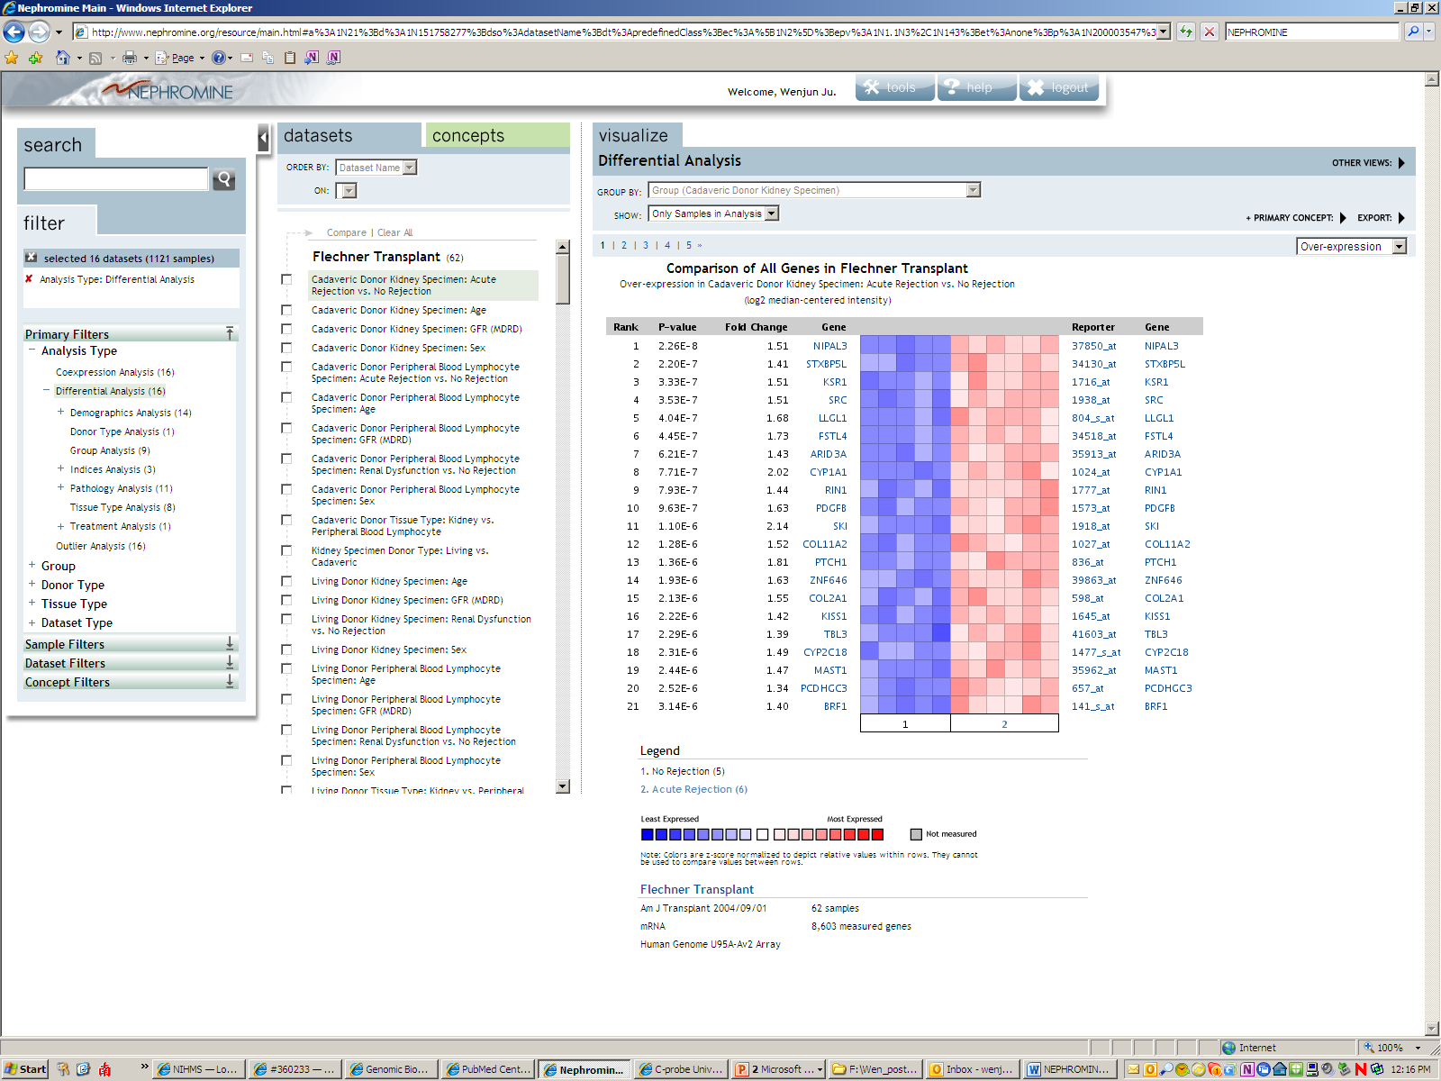
Differential expression – Dataset search
Export

Slide 38
Differential expression – dataset search – compare analysis
Compare different analyzes
Data is standardized on upload (centered to 0 and standardized by variance)
all features are mapped to common identifier (EntrezGeneID)
Notes:
meta-analysis of gene expression across studies including concept analysis using gene set
enrichment tools, and displays molecular interaction of co-regulated genes. The automated integration of 12
different external resources into the data warehouse, working in the software background, allows user-friendly
data export and analysis.
a meta-analysis combines the results of several studies that address a set of related research hypotheses. In its simplest form, this is normally by identification of a common measure of "effect size", for which a weighted average might be the output of a meta-analyses. Here the weighting might be related to sample sizes within the individual studies. More generally there are other differences between the studies that need to be allowed for, but the general aim of a meta-analysis is to more powerfully estimate the true "effect size" as opposed to a smaller "effect size" derived in a single study under a given single set of assumptions and conditions.

Slide 39
Meta analysis
Find out which genes are significantly more expressed in glomeruli compared to tubulointerstitium
Can you verify that with another dataset?
Or with more than one other dataset?
Does it matter if the datasets are different?
Can you imagine a use of this functionality for an exclusive filter (NOT)

Slide 40
Example

Slide 41
Concepts Analysis
Concepts are sets of genes representing some aspect of biology.
Concepts are derived from both Nephromine gene expression signatures as well as third-party sources such as Gene Ontology, KEGG Pathways, Human Protein Reference Database, etc.
User can upload a self-defined custom concept (a set of genes) to Nephromine to explore it’s association with Nephromine and third-party concepts.

Slide 42
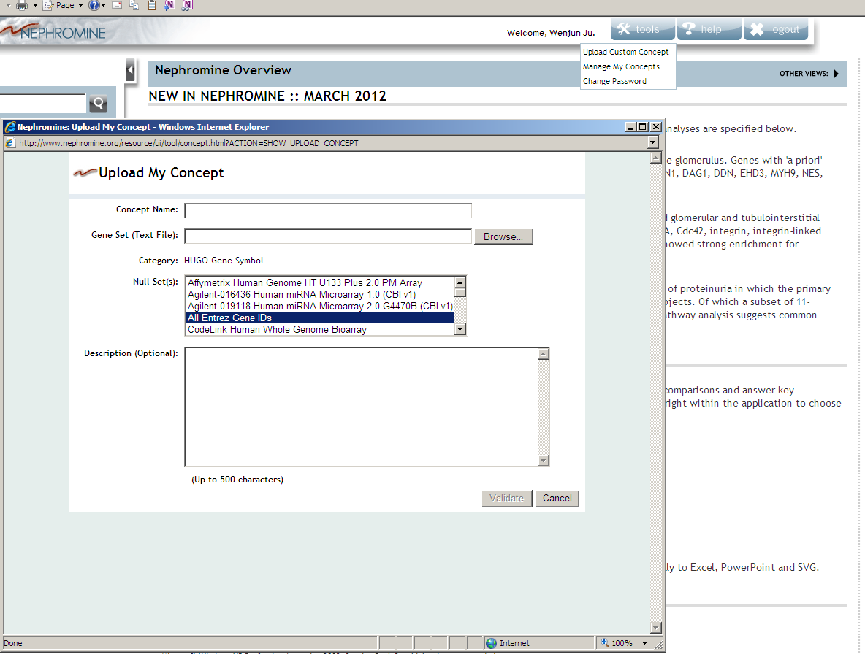
Concepts Analysis
Upload Custom Concept
Manage My Concepts
Change password
Podo-50-symbol
Download list from C-tools
to the desktop, then upload
The press "validate”
Notes:
concepts are sets of genes representing some aspect of biology. Concepts are derived from both Nephromine gene expression signatures as well as third-party sources such as Gene Ontology, KEGG Pathways, Human Protein Reference Database, etc.
When you first add a primary concept, the system runs a concept association analysis and displays the Concept Summary view.

Slide 43
Concepts Analysis
Upload
Then press “Upload”
Concept (Podo-50-symbol) validated successfully.

Slide 44
Concepts Analysis
Upload
Concept (Podo-50-symbol) was successfully uploaded and can be viewed in My Concepts
Select (Podo-50-symbol) as primary concept now.

Slide 45
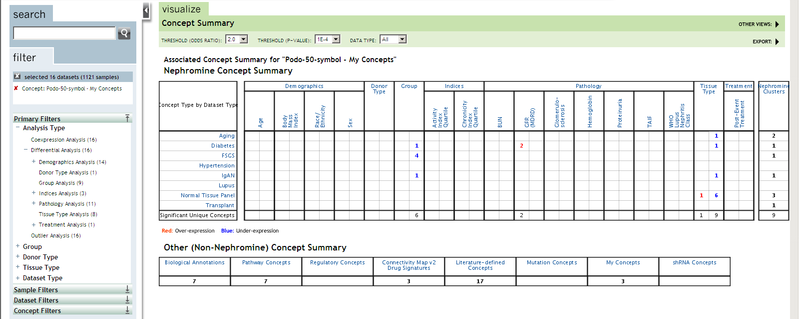
Concepts Summary View
Nephromine Concept Summary
4 concepts meet your threshold and are associated with the primary concept
Other (Non-Nephromine) Concept Summary

Slide 46
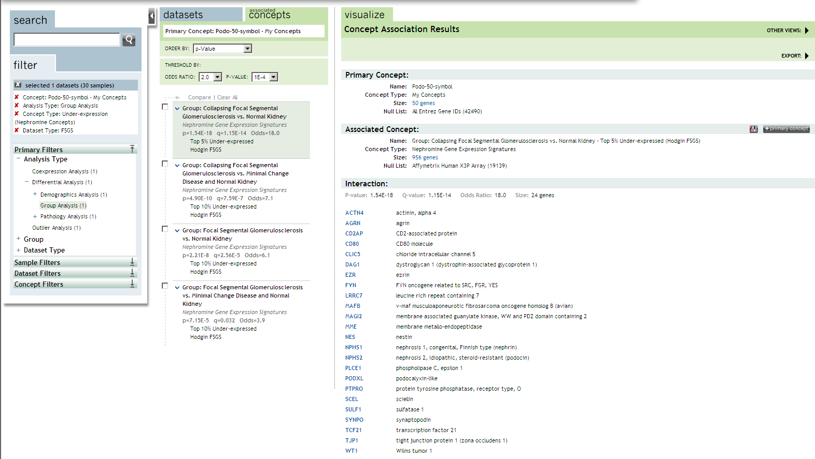
Concepts Analysis
COLL FSGS vs. Normal kidney
Nephromine Gene Expression Signatures
P=1.54E-18, q=1.15E-14, Odds=18
Top 5% Under-expressed
Hodgin FSGS

Slide 47
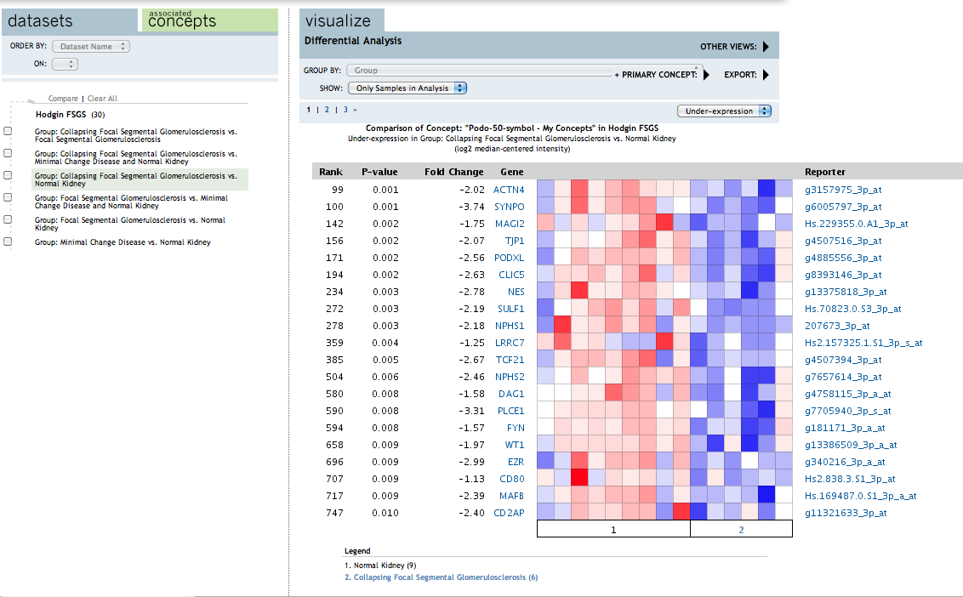
Concepts Analysis
PowerPoint
Publication‑quality graphic (SVG)
Excel ‑ Analysis Comparison
Excel ‑ Analysis Gene List
Excel ‑ Dataset Detail

Slide 48
tranSMART

Slide 49
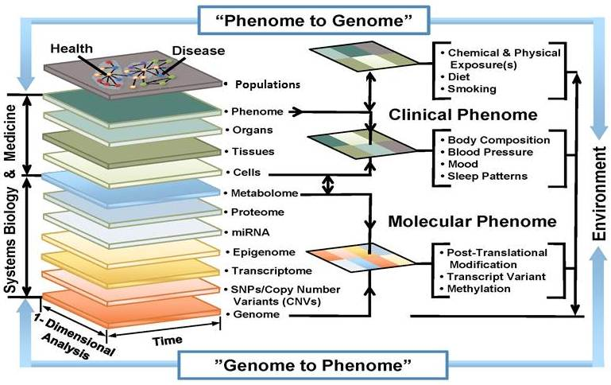
The Translational Challenge: Data Integration & Analysis
Athey and Omenn, 2009
Notes:
Translational medicine uses a multitude of various data to identify the molecular and clinical phenotypes, their connections
NEPTUNE enables us for true translational medicine

Slide 50
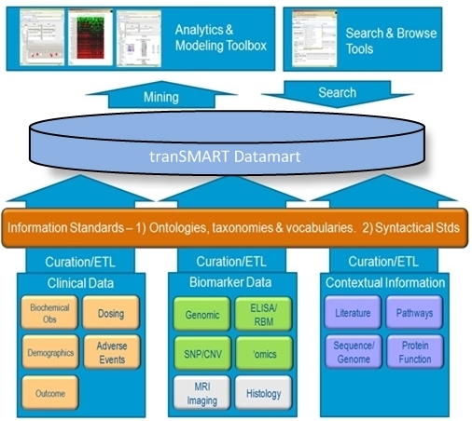
tranSMART Platform: Enabling Translational research
tranSMART – A platform and community
Open-source and open-data translational biomedical research community
Biomedical Researchers, Developers, Service Providers
Clinician Researchers
Notes:
We would like give you a first look into Transmart a platform for data storage, sharing and analysis, that we have been exploring for its potential use in Neptune. We would like to hear your feedback, your suggestions, features you would like to have implemented…

Slide 51
tranSMART Platform: Academics and industry
2009 Johnson and Johnson
2010 Sage Bionetworks
2012 FDA
2012 Pfizer
2012 St. Jude, Harvard, Johns Hopkins Univ.
2010 Thomson Reuters
2012 One Mind for Research
Notes:
As repository (all)
For internal sharing (all)
For data exploration with the inbuilt tools (OneMind)
For sharing between institutions (OneMind)
For easy data exchange (Takeda)

Slide 52
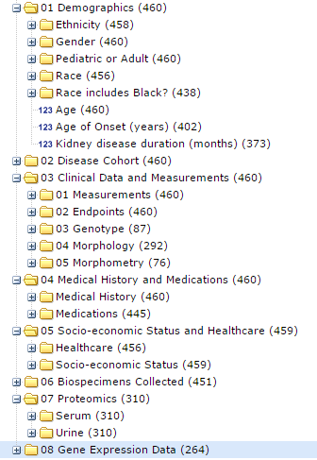
tranSMART: controlled vocabulary

Slide 53
Subset selection
Can further
specify with
AND or
exclusion
Subset 1
Subset 2

Slide 54
Summary statistics 1

Slide 55
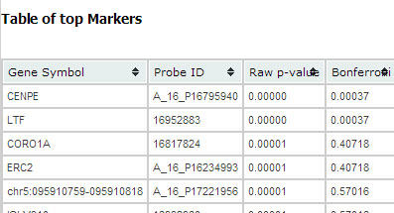
Differentially expressed genes
Gene symbols
P-values
Fold change
Enlarged:

Slide 56
Comparisons can be saved/emailed

Slide 57
tranSMART – why do we care?
Enables data exploration with low hurdles
Integrates many different data types
Has interfaces to real analysis tools
Provides a consistent data set
Can be run locally/ institutional etc
Can possibly be “shared” across institutions
McMurry et al, PLOS one: Shrine: enabling nationally scalable Multi-site disease studies
Go to: http://transmartfoundation.org/

Slide 58
Acknowledgements
Matthias Kretzler
Felix Eichinger
Wenjun Ju
Sebastian Martini
Viji Nair
Celine Berthier
Laura Mariani
Becky Steck
Colleen Kincaid-Beal
Rachel Dull
Daniel R. Rhodes
Rodney Keteyian
Becky Steck
Colleen Kincaid-Beal
Rachel Dull

Slide 59
Homework for fun
Connectivity map
Use Diabetes vs. control (tubulointerstitium dataset)
Select top 1% overexpressed as primary concept
Compare to significantly overlapping concepts with Connectivity map
Can you find potential drug candidates? Are there any drugs that work for both glom. and tub?
What could be optimized? How will you plan further experiments to test your hypothesis?

Slide 60
